Slide 1
Order Management Case Study Discoveries
Xiaohong Deng

Slide 2
Objectives
Order Management Bus Matrix
Fact Table
Dimension Table
Accumulating Snapshot Fact Table

Slide 3
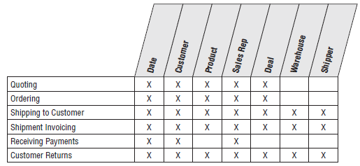
Order Management Bus Matrix
What’s a Bus Matrix? A powerful tool to
Address Agile Approach Shortcomings
Common Criticism: Lack of Planning, Architecture, and Governance
Encourages Collaboration Between Business and IT Stakeholders

Slide 4
Order Management Bus Matrix
How does Bus Matrix work?
Rows: Business processes
Columns: Dimensions
Shaded cells: If a dimension associated with a business process
Why does this matter?
Fact Table Measures Translated from Business Process performance metrics

Slide 5
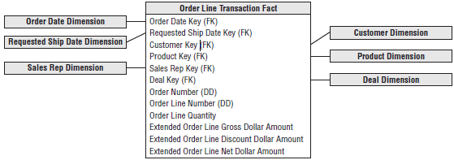
Fact Table
Review Facts: mostly numeric data that tells you information about “something” Fact Normalization
What is Fact Normalization?(a single generic fact amount along with a dimension)
When is Fact Normalization the right choice?(diverse quality test data in manufacturing)
When it isn’t the answer?(relational star schema databases)

Slide 6
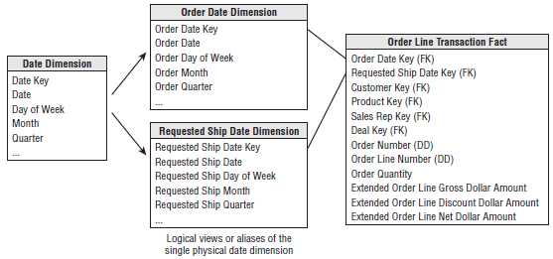
Dimension Table
Review Dimensions: are the “something” that you want to know information about.
Dimension Role Playing
Wrong: simply join these two foreign keys to the same date dimension table in SQL
Solution: create Logical views for each roles.

Slide 7
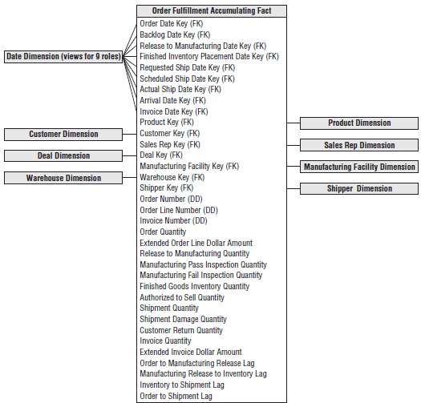
Accumulating Snapshot Fact Table
Review Fact Table Type:
Transaction Fact Table
Periodic Snapshot Fact Table
Accumulating Snapshot Fact Table

Slide 8
Accumulating Snapshot Fact Table
Accumulating Snapshot Fact Table:
What is "Accumulating Snapshot Fact Table"?
A fact table provides a real-time view of a process, constantly updating its major milestones.
When do we use "Accumulating Snapshot Fact Table"?
Perfect for Detailed Process Analysis: Ideal for Short, Clear Processes. Enables Real-Time Monitoring and Bottleneck Identification.

Slide 9
References
Kimball, R., & Ross, M. (2013). The data warehouse toolkit the definitive guide to dimensional modeling (3rd ed.). Wiley.

Slide 10


